Slide 1
Hashing Lab
1. Given the following key values, show what the data structures would look like after insertions
27 53 13 10 138 109 49 174 26 24
(no preprocessing necessary: p_{k} = key)
Linear array of 10 elements using division hashing
and the linear-quotient collision path algorithm
N = 13, 4k+3 prime = 19
LQHashing:
1. ip = pk % N
2. q=pk/N
if (q%N != 0)
offset = q
else
offset = 4k+3 prime
3. While collisions:
ip’ = (ip + offset) % N
4. Set Array[ip]=key
Bucket hashing of 10 elements (N=10) ip = (p_{k}) % N
Array:
Array:
0
1
2
3
4
5
6
7
8
9
10
11
12
13
0
1
2
3
4
5
6
7
8
9
10
27
26
109
53, 13
174,24
53
49
26
27
138
138
10
109, 49
174
24

Slide 2
2. Fill in the table based on exercise 1. Please look at slide 4, I could not enter numbers in this table. Thus, provide drawn table with numbers. Thank you!!!
Number of comparisons to retrieve this element
Key
Linear array -
(Length of
Collision Path +1)
Buckets -
(# of elements
in linked list
compared)
53
138
109
49
174
26

Slide 3
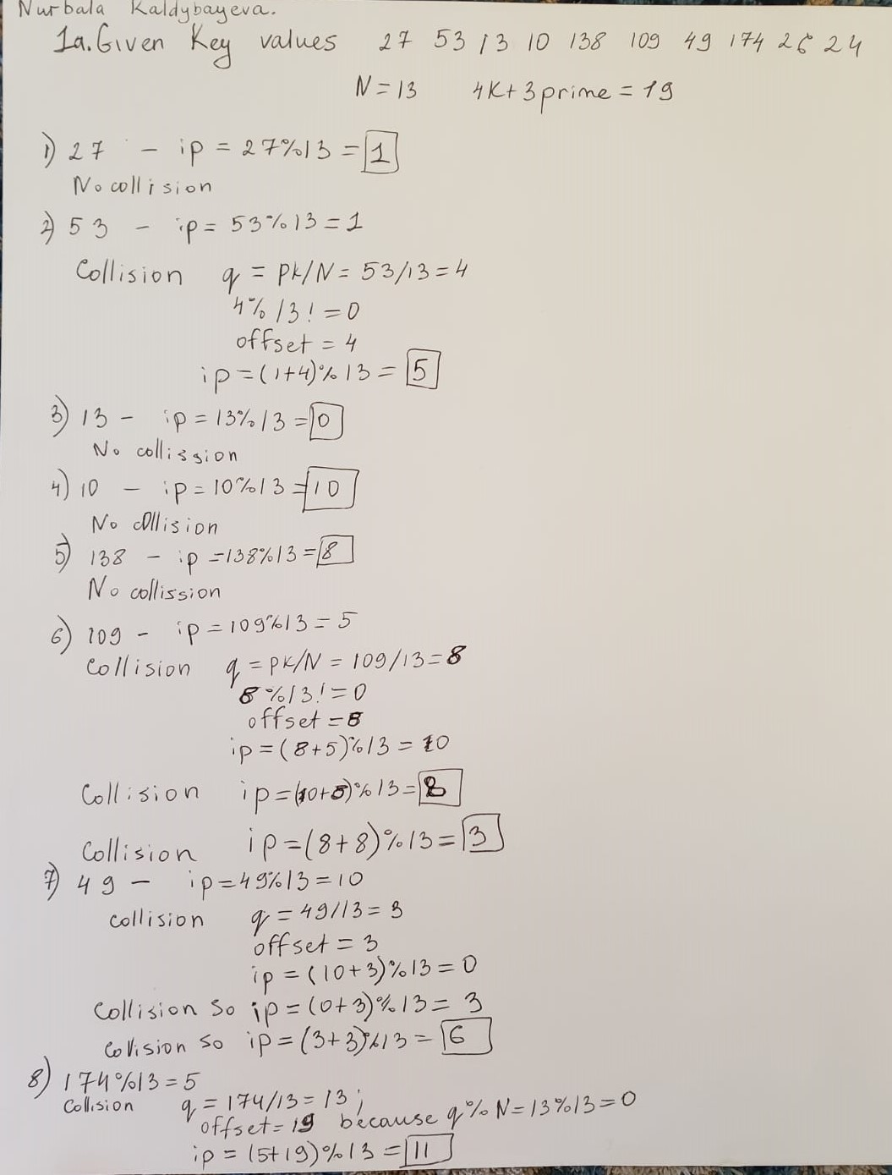

Slide 4
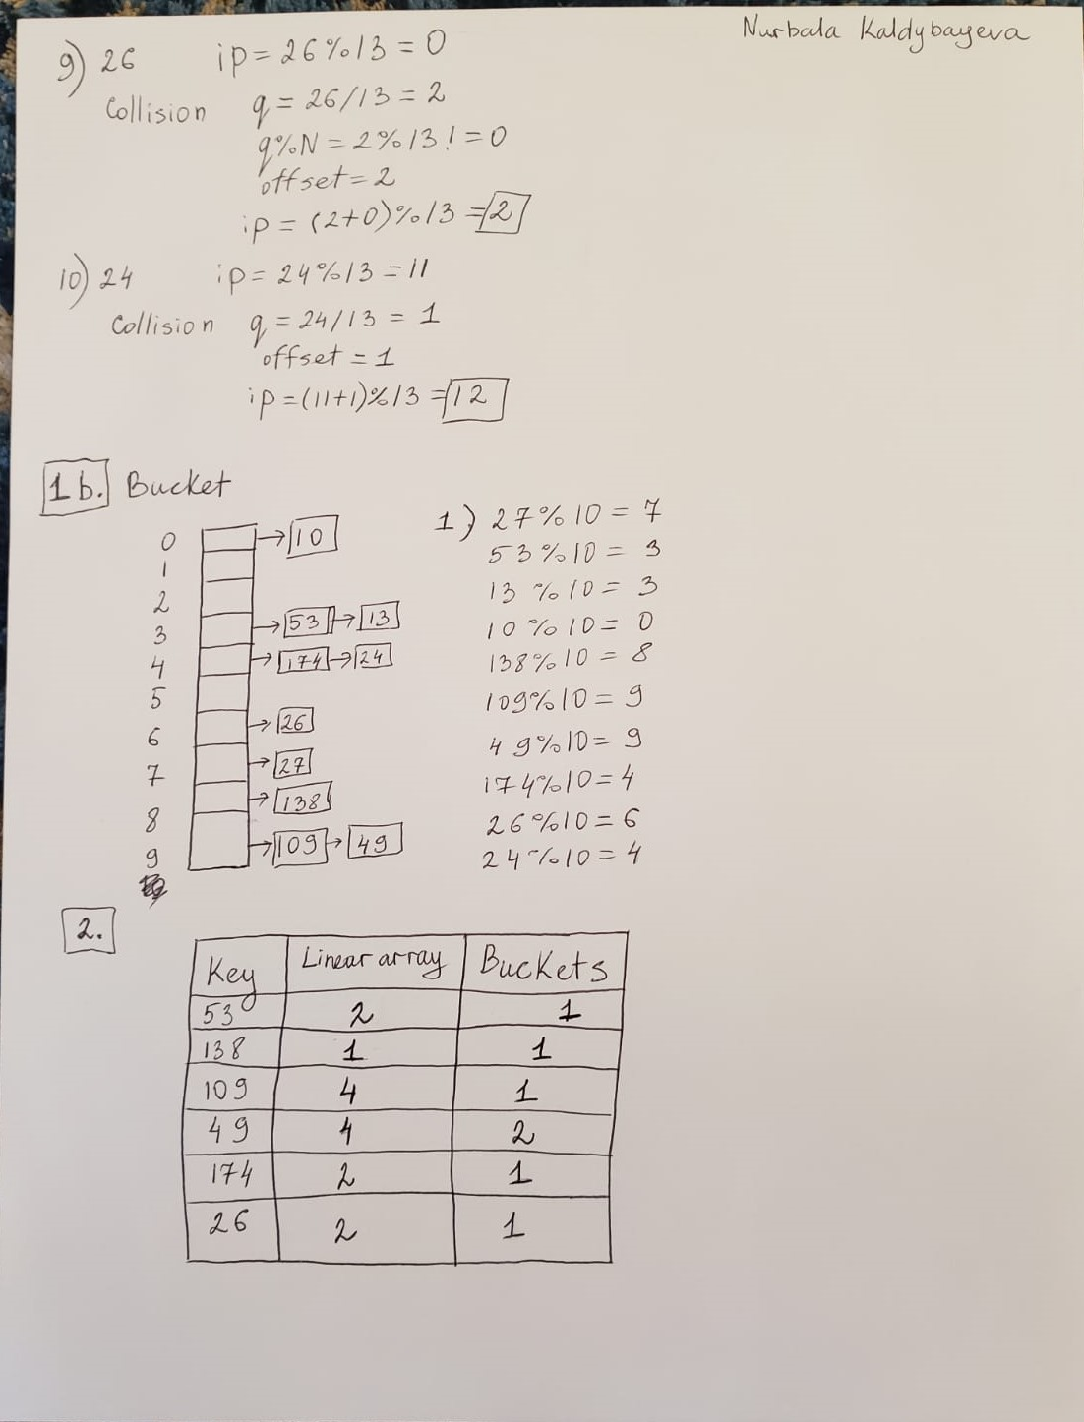

Slide 5
